Slide 1


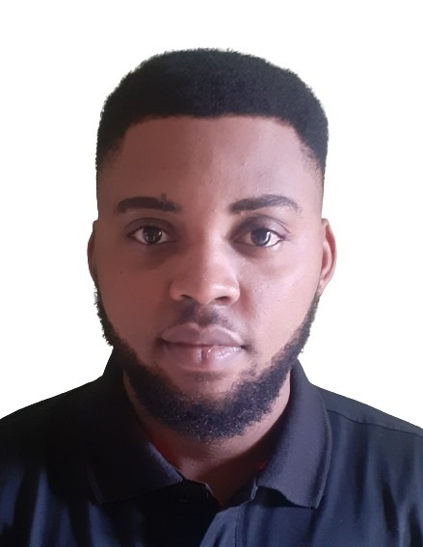
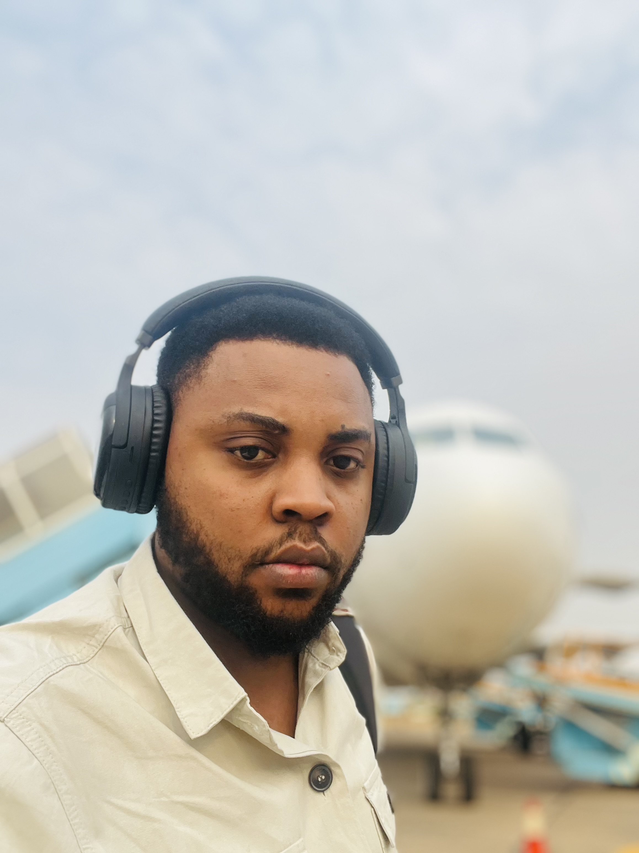
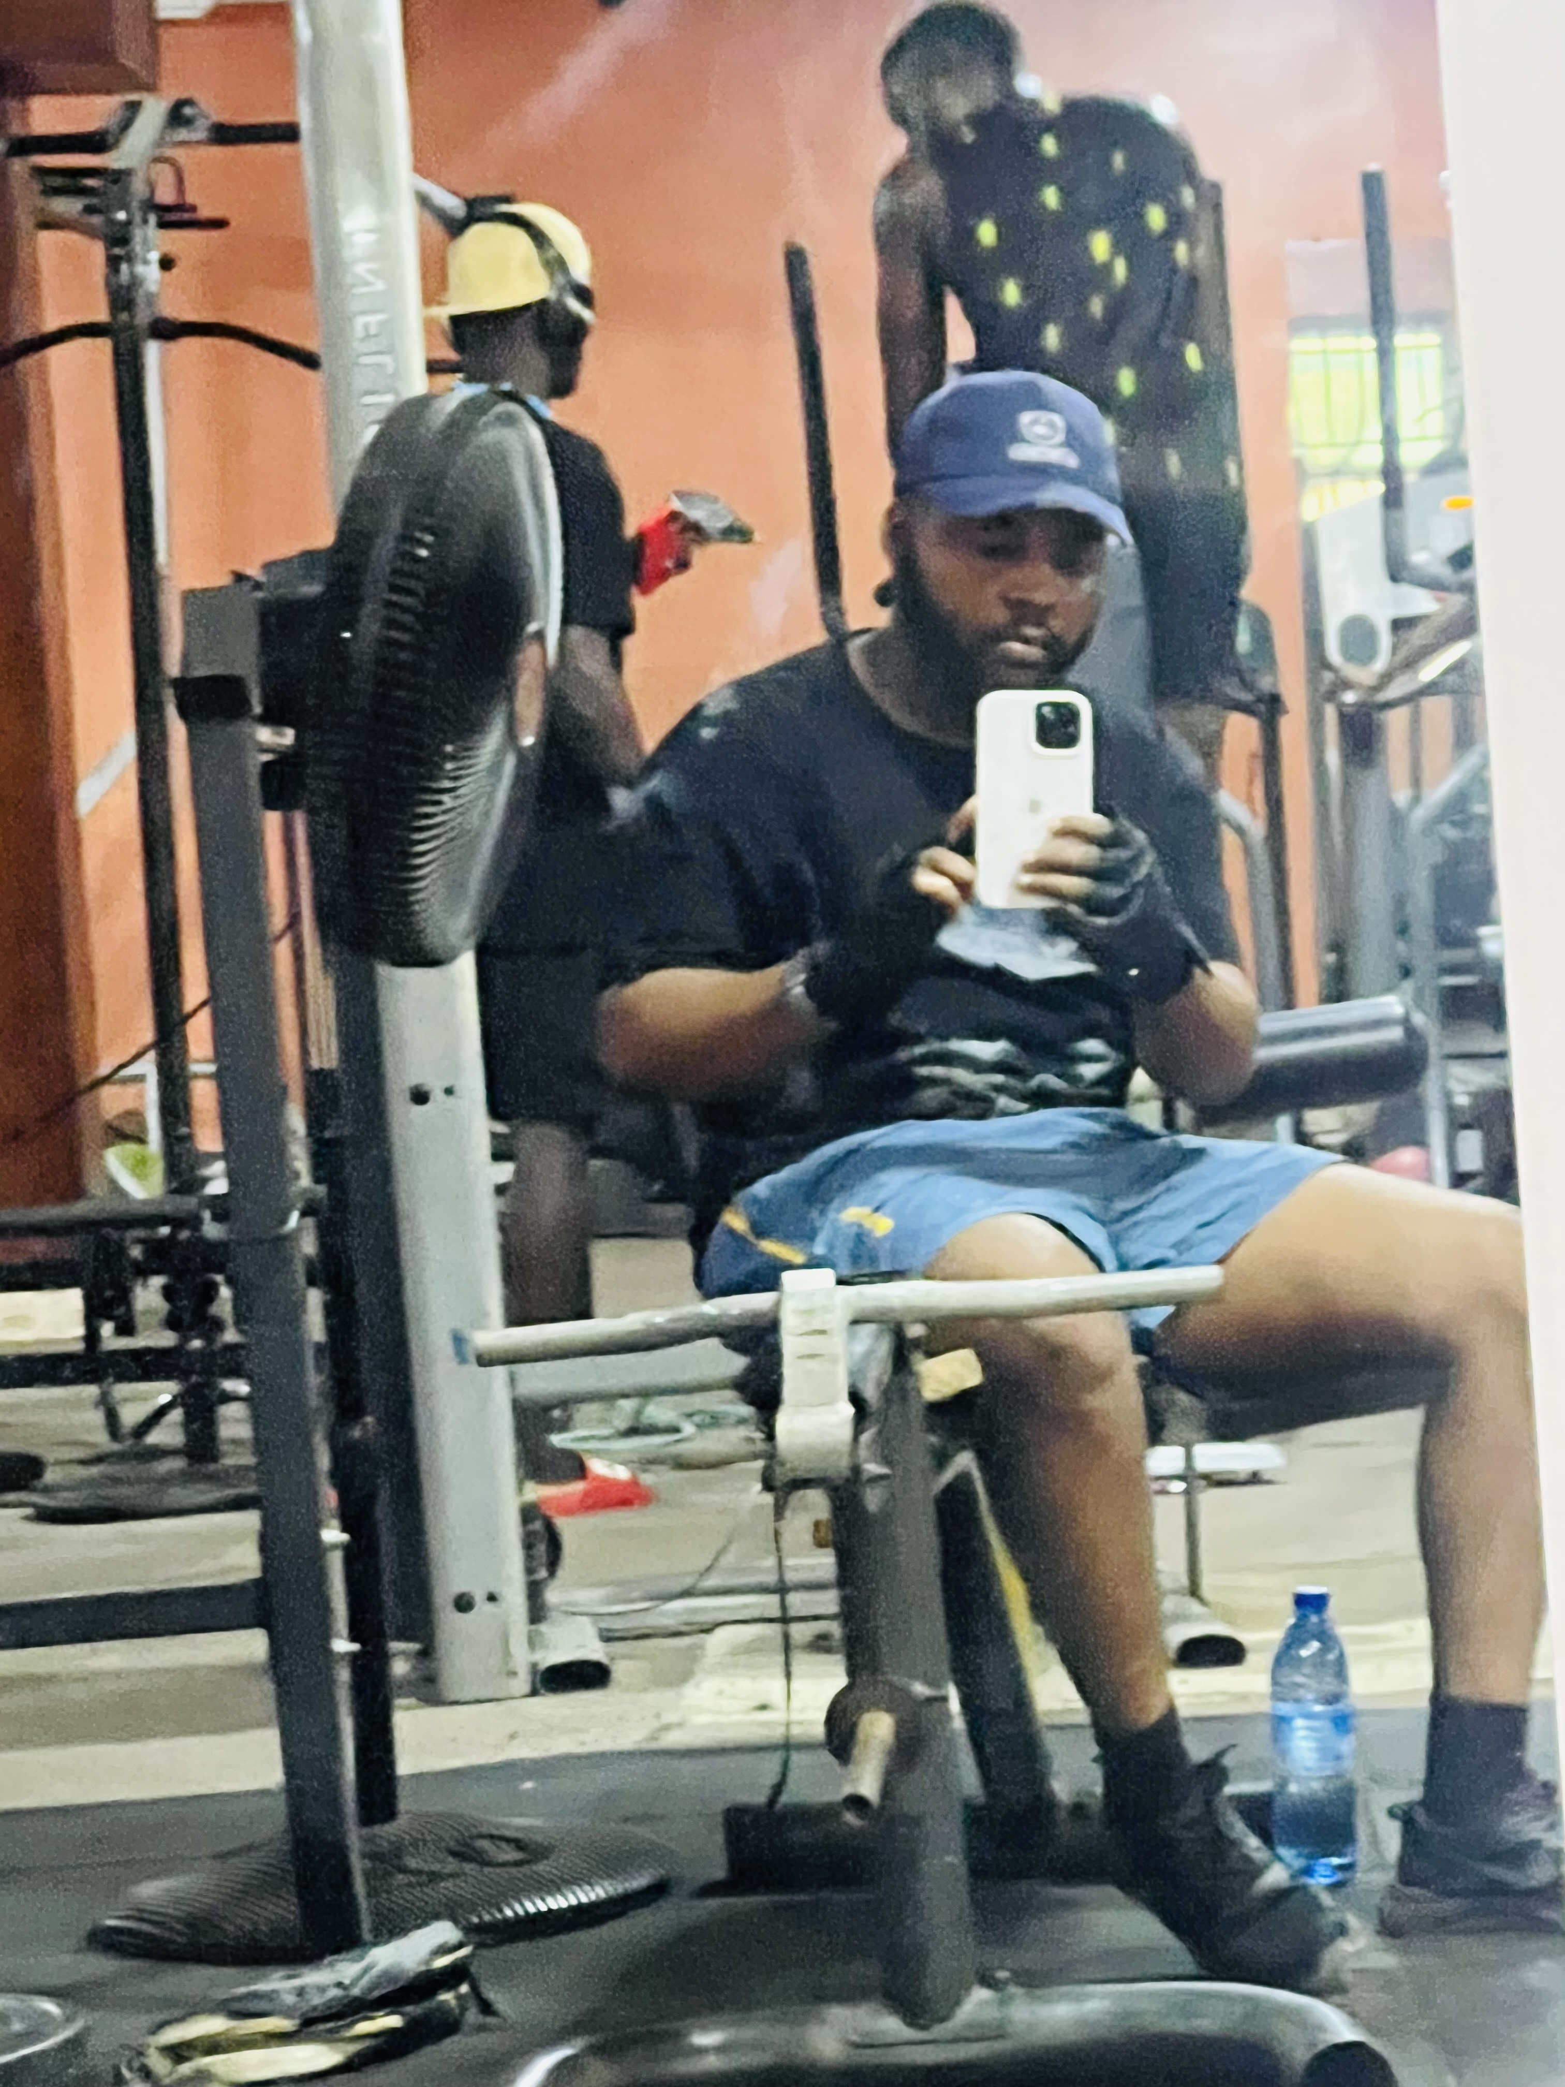
Getting to Know Me
Work
Personal
My role
Tzonal Head (Procurement)
Significant others / family members / furry friends in my life
My wife (Mary Okafor), my parents (Elder Okafor and Mrs Florence) and my siblings (Engr. Blessing and Engr. Daniel)
Tenure in ofi/Olam
T7 Years
How I enjoy spending my free time
Watching football, working out and listening to music
Previous companies I have worked at
Ministry of Agriculture, Uyo
My favorite / comfort food
Pounded Yam and Egusi soup
Why I joined ofi/Olam and what keeps me here?
I joined Olam simply because of her massive contribution to agribusiness on a global scale. What has kept me here is the impactful, Strategic and dynamic nature of the work, which has helped my personal development greatly.
My favorite song
1,000 miles by Mark Schultz
Chuks Okafor
‘what name you prefer to be called’
My air-pods are always in, whether I am tracking procurements or tracking beats
I believe every successful workday deserves a good closing track and sometimes a dance.
This is me outside work, doing stuff I enjoy in my life …

